Slide 1
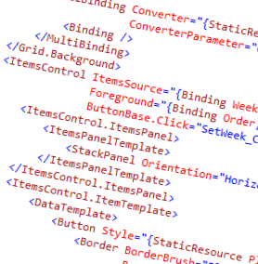
WPF and XAML
1 – What is WPF and XAML?

Slide 2
Overview
What is XAML?
Why XAML?
How it works
Why XAML is awesome
Elements of a WPF app

Slide 3

What is XAML?
eXtensible Application Markup Language
Declarative markup language
Specifies UI, code behind, events, data binding, styles
Platform independent
WPF is a desktop implementation of XAML

Slide 4



Why XAML?
Separation of Design and Code
Wireframes, Photoshop
Implement GUI
Implement behavior
Implement GUI in XAML
.NET instances
Implement behavior

Slide 5
How it works
Compiled to binary
Can have code-behind
XAML file
/ code
XAML
processor
code
compiler
app
executable
C# source

Slide 6
Cool stuff about XAML and WPF
Declarative layout
But you can do it all programmatically
Look of a control is separate from its behavior
Appearance can be applied through styles
Complex data binding is built in
Routed event architecture
Dependencies managed automatically
With proper coding you can get separation of UI and business logic
Took a lot of the lessons learned from HTML / Web

Slide 7
XAML Components
Layout with Panels: Canvas, Grid, StackPanel
UI Elements: TextBox, Grid, Combobox
Any object can be used in XAML
As a resource
Or as a visual element
Resources: Objects that can be found and used in XAML by “key”

Slide 8
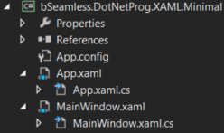
Elements of a minimal WPF app
App.config
App.XAML.xs
App.XAML
MainWindow.XAML.cs
MainWindow XAML

Slide 9

App.XAML.cs
Code behind for the app
Empty by default
Many methods for app lifecycle

Slide 10
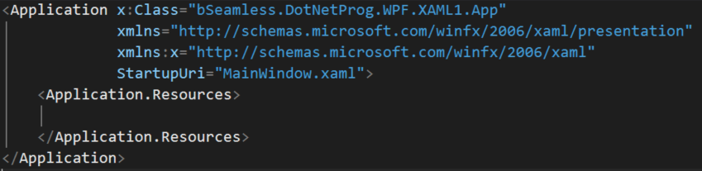
App.XAML
Holds app level resources
StartupUri specifies the first window
Note the use of namespaces

Slide 11
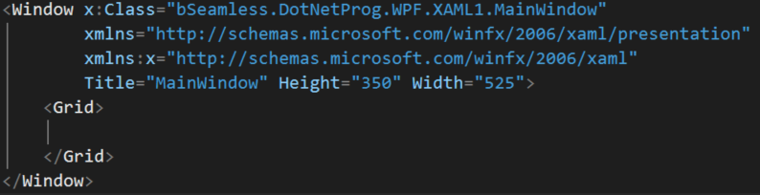
MainWindow.XAML
Specified layout of the window

Slide 12
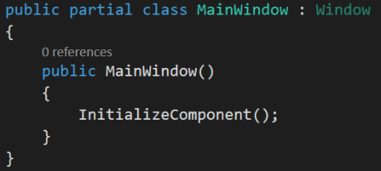
MainWindow.XAML.cs
XAML files have code-behind
InitializeComponent() is critical
Initializes all XAML controls on the window

Slide 13
Named and keyed objects
Objects with names (x:Name=“”) get generated code-behind
Objects with a key (x:Key=“”) are resources and can be referenced by other XAML markup

Slide 14
Summary
XAML is declarative UI specification including
Visuals
Interaction
Data binding
Multi-platform
Promotes developer and programmer integration

Slide 15
Demo
Walkthrough creating a default WPF app from VS.NET
Adding a text block
Naming the text block
Examining the generated code for the text block

